Slide 1


How do we make attendance everyone’s business?
Learning through lived experience?
23rd May 2023
Redcar & Cleveland Change Development Project

Slide 2
What do we want to achieve through this Project?
RCBC’s long-term goal is to improve attendance for children and young people in Redcar and Cleveland schools and colleges, with the wider long-term benefits for their health, wellbeing and economic prospects.
This Project being supported in 2023 will seek to make attendance everyone’s business in Redcar and Cleveland.

Slide 3
What the Project seeks to understand
Understanding…..
The evidence
The data
The area’s/system’s strengths
The protective factors (that encourage good attendance)
The risk factors (that make absence more likely)
Understanding…..
Who is absent and why
Who is affected and how
Lived experience
Things that help
Things that get in the way
Behaviours and choices
Root causes

Slide 4
What the Project seeks to understand
Understanding…..
Who is in the ‘system’
Who is not in the ‘system’
What is strong
What is wrong
What could be better if…
What the culture is
What behaviours help or hinder
Understanding…..
Strengths
Opportunities
Aspirations
Resources

Slide 5
7th March 2023 workshop
18 contributors gathered at Redcar & Cleveland House to:
Start to understand a bit about the children and families they reach and the contexts where support is provided (home, school, community)
Highlight any past, current or planned approaches to working with people with lived experience or co-production
Practice some scenarios where we might support participatory approaches for this Project with young people or parents/families
Consider why some children and young people do not attend at all or well at school or college
We also reminisced about our favourite childhood toys…..☺

Slide 6




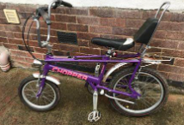
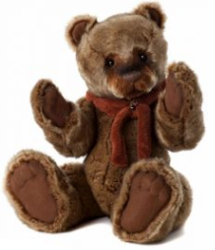



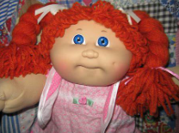
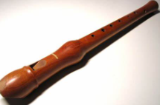


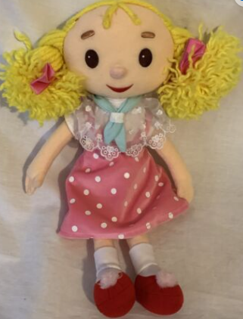



Slide 7
Four our next gathering (today)
We wanted to meet again because there was so much energy and enthusiasm to ‘make attendance everyone’s business’. We could concentrate on a couple of things:
1: How we can each go away confidently and have conversations, capture ‘journeys’ / case studies about the children, young people and families that we are seeking to work with to understand and overcome persistent and severe absence.
2: Identify practical suggestions and commitments for encouraging lived experience participatory approaches in Redcar and Cleveland for 2023 to support the Project.
We will seek to have some further stimulus at the event (tbc) depending on how willing some of the contributors from the first session are to help us connect with some of the real life insights they shared.
Notes:
1: we might seek to design the conversation scripts and be clear about who we wish to listen and talk to, why, when and how we capture and share the insights for the Project.

Slide 8
What are the opportunities for collecting stories and lived experience insights?
We think each participant would like to collect stories / develop case studies with people they engage with or support and be involved in helping us understand the reasons why some young people and families struggle to attend well – and how to overcome barriers and challenges.
We all seem especially interested to know about those young people who have been, are or might be at highest risk of becoming persistently or severely absent. We also want to know how young people / families in these situations have or could turn things around for the better.
We will focus on this in our next session together and think about how, when, where and with whom we might collect stories have confident conversations and build our understanding.
What are the practical opportunities for collecting stories or ‘journeys’ between June and September?
What might the conversations look and feel like, where might they happen, how do we ‘record’ them and bring them back in to the Project?
Who might complete the conversations – do we / others have the skills, the confidence, the trauma informed practice and anything else we feel essential?

Slide 9
23rd May Session at Tuned In!
Event purpose
To gain confidence and commitment from everyone here today to collect ‘stories and journeys’ by September which help us understand the lived experience of children and young people struggling to attend or are, at a higher risk of becoming, persistently or severely absent.
Engagement with families, parents or primary care givers could also reveal their lived experience, and together these stories could illuminate small or big changes that would make it easier and attractive for CYP to attend.
Have situations been turned around? What can we learn from those stories and journeys to inform the way we serve, support and encourage attendance?
And what do we think needs to be done in Redcar & Cleveland to ensure that lived experience of CYP and their families / care givers are at the heart of any changes made in future to improve attendance?

Slide 10
We might like to consider….
Persistent absence is equivalent to missing 1 day at school every fortnight.
Whilst attendance was 92.3% on the 27th of April, there were 3,618 CYP defined as persistently absent (missing 10% or more of sessions) and 408 were severely absent (missing 50% or more sessions). This is out of 19,079 pupils at 49 schools in the Borough.
The Education Select Committee continues to collect evidence about persistent absence and support for disadvantaged children
Parliamentlive.tv - Education Committee – 7th March 2023
Parliamentlive.tv - Education Committee – 16th May 2023
Terri White: How I fear for the 'ghost children' missing from school - BBC News
'Huge' number of children miss school on Friday because their 'parents are home' (msn.com)

Slide 11
Break out discussions at each table
Who are you working with?
How could you collect their stories / journeys June-September?
What might the conversations feel like:
3a) Where would the conversations happen (is the setting safe and confidential and has consent been agreed)
3b) Who would do them and do they have the skills, trauma informed approach to complete with confidence (any gaps/ support needed?)
3c) What questions would you use / ask the CYP / family?
3d) How could stories be shared back for this Project?
What might a story / case study / journey look like?
What might a story / case study / journey look like – what do you think the structure for the story might be?

Slide 12





Lived experience of children and young people with Special Educational Needs and Disabilities that become persistently absent
The 2 leading causes of persistent absence amongst CYP with SEND are: 1: Mental Health challenges (chiefly anxiety) and 2: Unmet (including unidentified) need. The Education Select Committee heard this journey described as a ‘self-propelled process of escalation for the child as a result of their unmet need.’ (16th May 2023, Link to Parliament TV found in notes)
The child has unmet needs
They have poor or traumatic experiences in the school / college environment
They feel increased anxiety or mental health challenge
Leading to non-attendance or placement breakdown
The child internalises more than before
This puts increased pressure on home and family life
The child externalises through behaviours and attendance starts to suffer
Notes:
Parliamentlive.tv - Education Committee

Slide 13
Who are we working with?

Slide 14
Participants were reaching and supporting children, young people and families in multiple contexts
Young people struggling with their attendance
Young people on the edge of VEMT (aged 1-16)
Vulnerable children -multiple characteristics
Young people using youth& or VCSE services / activities
Young people being supported with their mental health
Young people at risk of exclusion / excluded
Young people with EHCP / SEND needs
Looked After Children
Any child with a social worker
Children missing from home / education
Children not known to social care
Young people ‘NEET’ 15-18/25 with an EHCP
Notes:
VEMT = vulnerable, exploited, missing , trafficked
NEET = Not in Education, Employment or Training

Slide 15
Participants were reaching and supporting children, young people and families in multiple contexts
Young people struggling with drugs, alcohol, substances
Young people suffering from neglect
Young people suffering from domestic violence
Children in Care
Children attending school / college
‘Whole families’ supported by Early Help
Families in safe accommodation
Refugee and asylum seeker families
Young / teen pregnant / parents
‘Extremely chaotic adults’
Young families to support best start in life (1,001 days)
Parents / families interacting with school

Slide 16
Participants were reaching and supporting children, young people and families in multiple contexts
Young people supported by health visiting and school nursing
Families with children ages 0 to 5 (healthy child programme)
Every 0-5 child transferred into the area
School nurses supporting 5-19 or 25 with SEND needs
Young people with SEMH needs
Young people with a long term limiting health condition
Children in Need / Child Protection
Care experienced / leavers / young carers
CONTEXTS..
SCHOOL / COLLEGE
HOME
COMMUNITY
Notes:
SEMH = Social, emotional and mental health

Slide 17
Additional insights about the children, young people and families

Slide 18
“A lot of our parents and families come with baggage, with a bad experience of school or society.”
“Health visitors do a lot of home visiting when older children are present and should be at school.”
“A lot of kids that need EHCPs don’t have them – they’re going on a path that loses them.”
“Some children are not attending school but are frequently ill – we explore with the parents whether this is genuine or not.”

Slide 19
“We have a lot of cases where the young person has school worries, issues with behaviour, non-attendance and exclusions.”
“We work in a huddle with others to discuss referrals and think about who is best to support them.”
“We come across cases where parents aren’t taking children to their medical appointments.”
“We work around whole families to support them into education, training and employment.”

Slide 20
“We support many families and young people in the voluntary sector – including our 464 registered charities in Redcar & Cleveland.”
“We need to think hard about how we reach and support people that don’t intersect with the system.”
“We’re in a very deprived area but we have successes, have amazing relationships with parents and we try different strategies.”

Slide 21
“I think there are a lot of undiagnosed needs amongst our young people.”
“Some of the young people we encounter have set themselves up in self-sabotage mode.”
“Our youngest administrator flinches when he thinks he might get in trouble owing to their school experiences. Trauma.”
“Wow! I’ve waited over 2 years to get this kind of expertise in the room, thank you!”
(Clare Mahoney, AD Education, RCBC)

Slide 22
Lived experience, co-production and participatory approaches

Slide 23
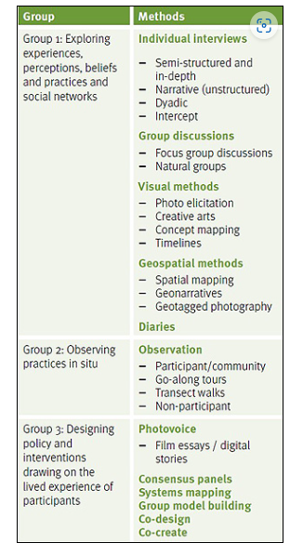
Plenty of interest to learn
‘Lived experience is the actual, specific ways in which people experience something.’
The group has lots of opportunity to collect stories and have conversations with the children, young people and families they work with.
Only a few have worked alongside a lived experience ‘group’ using participatory methods, and where that ‘group’ is leading the inquiry in the way they feel is right for them.
Some examples are found here but there is some jargon to break down. The point is there are different ways to do this and the people with lived experience should lead it.
Community researchers or reporters is often a favoured approach (do we have any?), or informal chats in safe peer to peer group settings can be really illuminating. Day in the life of, week in the life of diary / journalling can also be fun for some.
For this project we could collect stories together of course, but we might also seek to learn more about these more participative ways of working too.
Notes:
Quote 1: source Methods for lived experience research (the-sra.org.uk)
Research methods: Example only Centre for Food Policy Highlights of 2019 (city.ac.uk)
A wide range of qualitative methods is available to provide evidence of people’s lived experience of food environments, including in-depth interviews, photo elicitation, go-along tours, community observation, group model building, and co-design methodologies. Each method has different potential for gaining insights into how people interact with food environments.’
Quote 2:

Slide 24

Plenty of interest to learn
The phrase >>> is often coined by ‘experts by experience’ or people with lived or direct experience to others in a system such as commissioners or service developers who may intend to create benefits for them but forget or don’t know quite how to adequately involve and engage with them!
For this Project it’s the children, young people, parents and families who should ideally be at the heart of, and leading the conversation, and helping develop the solutions they want to see for themselves.
Maybe we can explore this principle through this Project in 2023 and beyond – test and learn, start small with some willing people in particular places or contexts and build from there?
Notes:
Quote 1: source Methods for lived experience research (the-sra.org.uk)
Research methods: Example only Centre for Food Policy Highlights of 2019 (city.ac.uk)
A wide range of qualitative methods is available to provide evidence of people’s lived experience of food environments, including in-depth interviews, photo elicitation, go-along tours, community observation, group model building, and co-design methodologies. Each method has different potential for gaining insights into how people interact with food environments.’
Quote 2:

Slide 25
Some useful real-life examples shared in the first session

Slide 26

South Bank Primary School
Tammy and Marie explained that their school sits in a very deprived area but that they have had successes with attendance through their nurturing approach, being trauma informed and the diversity of support on offer.
Relationships with parents are very close, especially in understanding and seeking to meet the social emotional and mental health needs of their child/ren.
They set up a parent group targeted at those with children in our care families, those whose children were struggling with attendance, were defined as CIN or CP.
It was initially led by the mental health nurse, but the parents guided what’s needed to improve their / child/ren’s experience ‘to break the cycle’. The group has grown.
They talk about housing, referrals to early help, health and other things that interest them. They don’t feel judged even though professionals are sat there.
Notes:
Attendance | South Bank Primary School

Slide 27
“If you break into one family that builds the trust.”

Slide 28
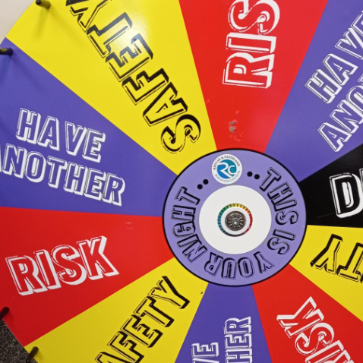
Youth Worker Insights
Two youth workers told the group how the young people they work with love coming into the office and ‘talking about stuff’.
They do talk about school, what they don’t like about school ‘especially in the East’.
They talk about sexual health and mental health is a HUGE topic for them – some feel confused, isolated.
They aren’t naughty, but they can feel like they’re not good enough or can’t get support from their family.
Primary school are ‘amazing, nurturing’ but the secondary schools don’t have the time or spare capacity to meet the needs of the individual.
Notes:
Image source: About youth clubs | Redcar and Cleveland (redcar-cleveland.gov.uk)

Slide 29
“When we do assessments and give them the magic wand, some young people want to get rid of school!.”

Slide 30
Why do some children not attend well?
They do not like school.
Fear.
Bullying.
They maybe a carer for a parent or not want to leave their parent.
Attending school does not make them feel good about themselves.
Parents are not encouraging them to attend.
Shame, embarrassment or stigma e.g. ‘I don’t have the right uniform’.
Struggling with their mental health rather than physical health.
Low aspirations – reinforced by multi-generational attitudes.
Cultural norms – travellers, parents from other countries/community being unaware of expectations.

Slide 31
Why do some families choose or struggle to support their child/ren to attend well?
Parents’ own negative experience of education.
Only hearing negative things about their child/ren in school.
Lack of understanding of the impact or importance or value of attending school and education.
Poor relationship with the school.
Some parents struggle to articulate their child’s needs to school.
Not prioritising attendance/ routine.
Low aspirations by child / parent not having aspirations for their child.
Family / parental relationships are chaotic affecting the child/ren.
Generational lack of parenting skills.
Poverty and how this drives choices and behaviours to not attend.

Slide 32
“When we speak to parents there’s a lack of communication in secondary schools, between different departments. This medical part didn’t tell this attendance part about the young person, and they didn’t tell that behavioural part, and safeguarding don’t talk to attendance. We find ourselves challenging when we shouldn’t or didn’t need to. Communication needs to be better all-round to properly manage the complexities of these children.”
Notes:
Source of quote: Early Help Team

Slide 33

Scenarios
Child-Centred Solutions
What would we want to know?

Slide 34
You are invited by some young people who want to lead some conversations with their peers in R&C schools / or youth clubs / or other community setting (tbc) to identify what’s important to them and what would make their lives better.
They are willing to consider including conversation topics that might be helpful to this project. Can you come up with a few conversation topics / questions that you might suggest alongside the young people wanting to do some peer participatory research.
Scenario 1

Slide 35

Ideas
Conversation topics for young people to speak to other young people / their peers about:
Can you tell us about a nice time or experience you had at school?
What would you like to achieve in school?
What could your school do to support you to achieve that?
What do you feel are the biggest issues for children and young people?
Role Play suggestion – Be the Boss!
If you were a Head teacher of a school what would your priorities be?
How would you make it enjoyable for students?
Notes:
Extra note
It would be useful somehow to explain to children and young people what cannot change within schools so that they understand what teachers have to provide. But how do we make this something conversational that a young person can talk to another young person about i.e. not having a professional tell them how things are or have to be?

Slide 36
You / your team are looking at co-production to improve your service in 2023 and beyond, and having heard about this attendance project you think there might be some value in embedding some conversation topics / questions in your plan for engaging with children and young people.
What sort of questions or topics might you include?
Scenario 2

Slide 37
Ideas
Conversation topics for service professionals to include in their work with children and young people:
Can you think of a time / day when you have really enjoyed school, what did this look like?
Who in school do you talk to?
What do you do when you are not in school?
What do you worry about?
What could your parent do to help you?
Thinking about mental health can you show / tell us what an unwell adult or child looks like?
How can we engage you better?
What opportunities could we provide to improve your life?
How could we use new technologies to support you?
Engaging techniques these professionals felt they could use
Tree – Ecomap (important people)
Family Circle activity
Tree houses
‘Throw a ball’ as part of the questioning
These participate techniques are encouraged, indeed any that enable the young person to express themselves in the way they choose.

Slide 38
Scenarios
Whole Family Working
What would we want to know?

Slide 39
A local community parent to parent peer support group has said they might be willing to have some conversations over the course of a month or two to explore what matters to them, their families and what would make their lives better.
They are willing to consider including conversation topics that might be helpful to this project. Can you come up with a few conversation topics / questions that you might suggest alongside the parents wanting to do some peer participatory research?
Scenario 1

Slide 40
Ideas
Conversation topics that parents might include in conversations with other parents in their peer support group or gathering:
What is our experience of school past and present – our lived experience?
What is our relationship like with school?
What do we think about:
Contact with school
Communication (named person, preferred method and frequency?)
Dealing with / discussing issues
Health
Peer pressure / support (for child/ren)
The engagement levels of staff
The routines at school (are they enough)
What does a good / bad day look like for our child/ren?
What do we think about the support provided by school to meet our child/ren’s needs?
Is there sufficient support to meet the needs of any child that has experienced / is dealing with trauma in their life?
In terms of any negotiated plans for our child/ren, is this driven by our child/ren, us as parents, the school or someone else?
What do we think about these plans – are they too controlling, too flexible, do we all know our roles and consequences for safety of our child/ren if there is a lack of commitment?
What do we think about all these relationships and set-up?
What would ‘better’ look like?
Notes:
Extra note
The group started by saying that they felt there were too many rules and that they felt there was a lack of support for children with trauma, that secondary staff have disengaged lately and that it is difficult to establish a working relationship.
In primary schools they struggle with morning routine, breakfast.
School and attendance is discussed during missing interviews.

Slide 41
You / your team / your organisation are looking at co-production with the VCSE sector and local communities to improve your service in 2023 and beyond. Having heard about this attendance project you think there might be some value in embedding some conversation topics / questions in your plan for engaging with families in communities alongside the VCSE sector.
What sort of questions or topics might you suggest are considered for the participatory research ahead?
Scenario 2

Slide 42
Ideas
Conversation topics that service professionals and or VCSE / community groups could have with parents/families across Redcar & Cleveland:
Where the conversations might happen?
‘At points of intersection e.g. where the families go, might be food banks or GP surgery, charities specialising in domestic violence or abuse, drop in community spaces where it is safe to chat
Parent peer support settings – develop a method for the parents to have these conversations for themselves
Warm spaces – offer free tea and coffee, again an opportunity to talk
Use technology
Talk to people on the street – ‘would get the most information from them at this point’
Questions
What are the key worries parents have?
What do they want for their child – now, in the short-term and longer-term?
Training first?
Conversations are happening every day but VCSE / people need training to ask more probing questions and we need to find a way of capturing the responses.
Perhaps something along the lines of MECC – Make Every Contact County or guided conversation scripts?
Other suggestions
Working with and through East Cleveland Good Neighbours
Food would be a good tool to encourage people to open up and talk about themselves and wider family concerns e.g. cooking together
Notes:
Extra note
The group started by saying that they felt there were too many rules and that they felt there was a lack of support for children with trauma, that secondary staff have disengaged lately and that it is difficult to establish a working relationship.
In primary schools they struggle with morning routine, breakfast.
School and attendance is discussed during missing interviews.

Slide 43
Next steps

Slide 44

Contact
Clare Mahoney
Assistant Director Education and Skills
Redcar & Cleveland Borough Council
Clare.Mahoney@redcar-cleveland.gov.uk

Slide 45
Contact
Amanda Olvanhill
Head of Employability Foundation for Jobs
Redcar & Cleveland Borough Council
Mobile: 07870 158812
Amanda.Olvanhill@redcar-cleveland.gov.uk

Slide 46

Contact
Alan Graver
Managing Director
Skyblue Research Ltd (York)
0794 000 4560
alan@skyblue.org.uk
www.skyblue.org.uk

